Slide 1
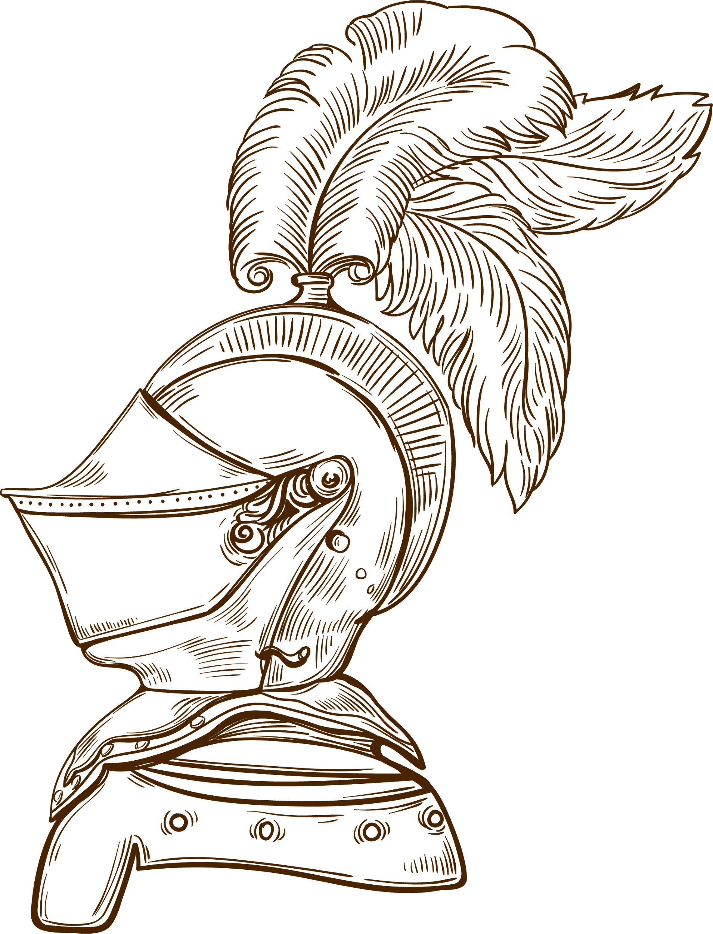
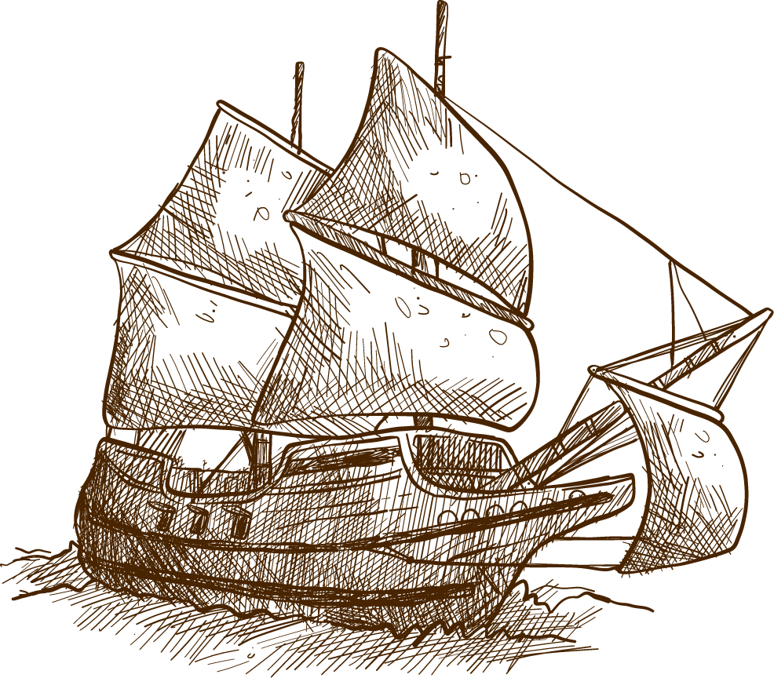
PAPYRUS HISTORY LESSON isinhvien
Here is where your presentation begins

Slide 2
01
03
OVERVIEW
ASSIGNMENT
02
FEATURES OF THE TOPIC
04
ABOUT THE TOPIC

Slide 3
—SOMEONE FAMOUS
“This is a quote. Words full of wisdom that someone important said and can make the reader get inspired.”

Slide 4
INTRODUCTION
Venus has a beautiful name and is the second planet from the Sun. It’s terribly hot—even hotter than Mercury—and its atmosphere is extremely poisonous

Slide 5
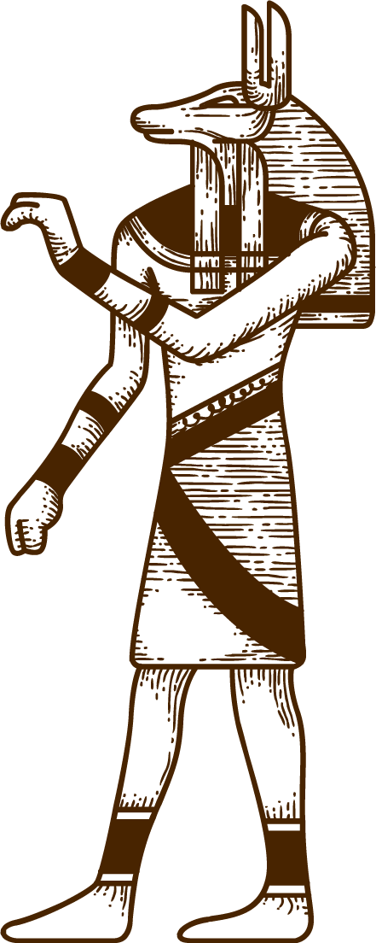
WHAT IS THIS TOPIC ABOUT?
MARS
Despite being red, Mars is actually a cold place. It’s full of iron oxide dust, which gives the planet its reddish cast
VENUS
Venus has a beautiful name and is the second planet from the Sun. It’s terribly hot, even hotter than Mercury

Slide 6
DEFINITION OF CONCEPTS
01
02
03
04
MERCURY
MARS
NEPTUNE
SATURN
Mercury is the smallest planet in our Solar System
Despite being red, Mars is actually a cold place
Neptune is the fourth-largest planet in our Solar System
Saturn is composed mostly of hydrogen and helium

Slide 7
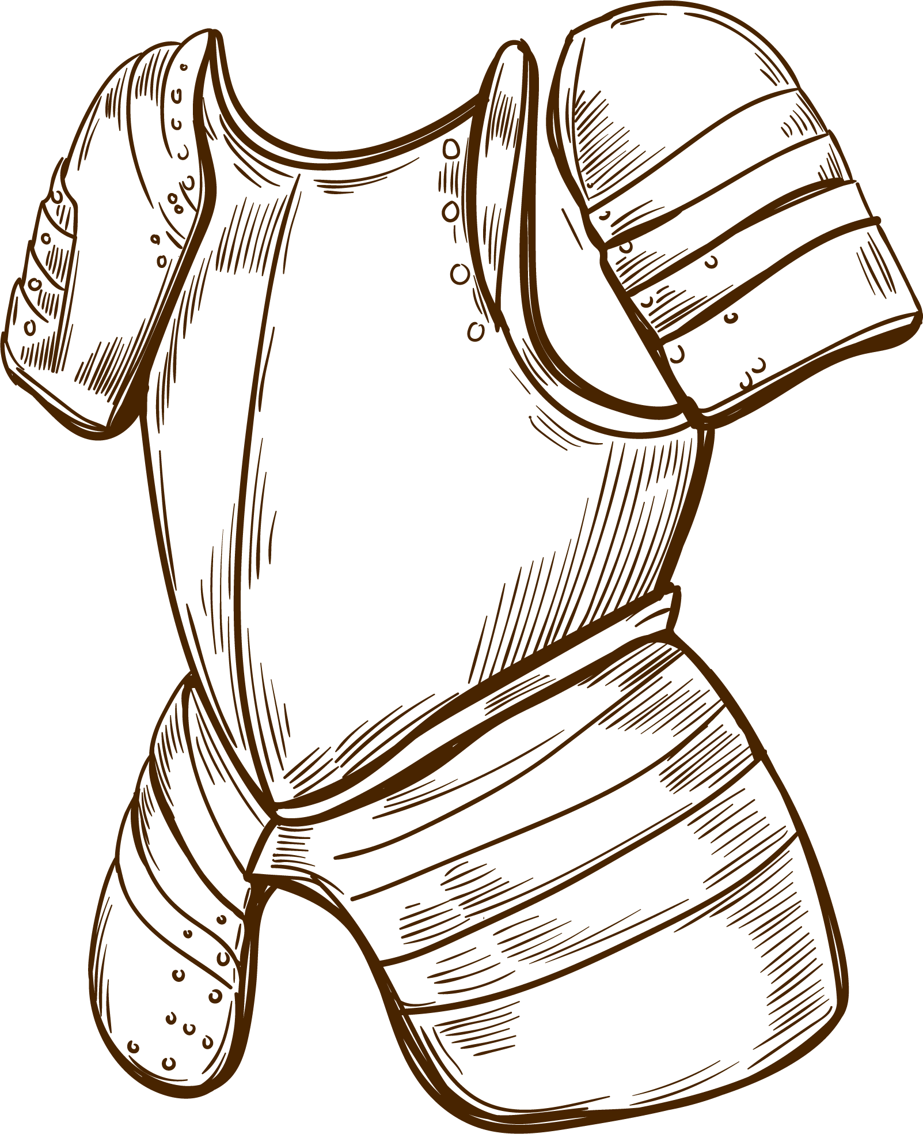
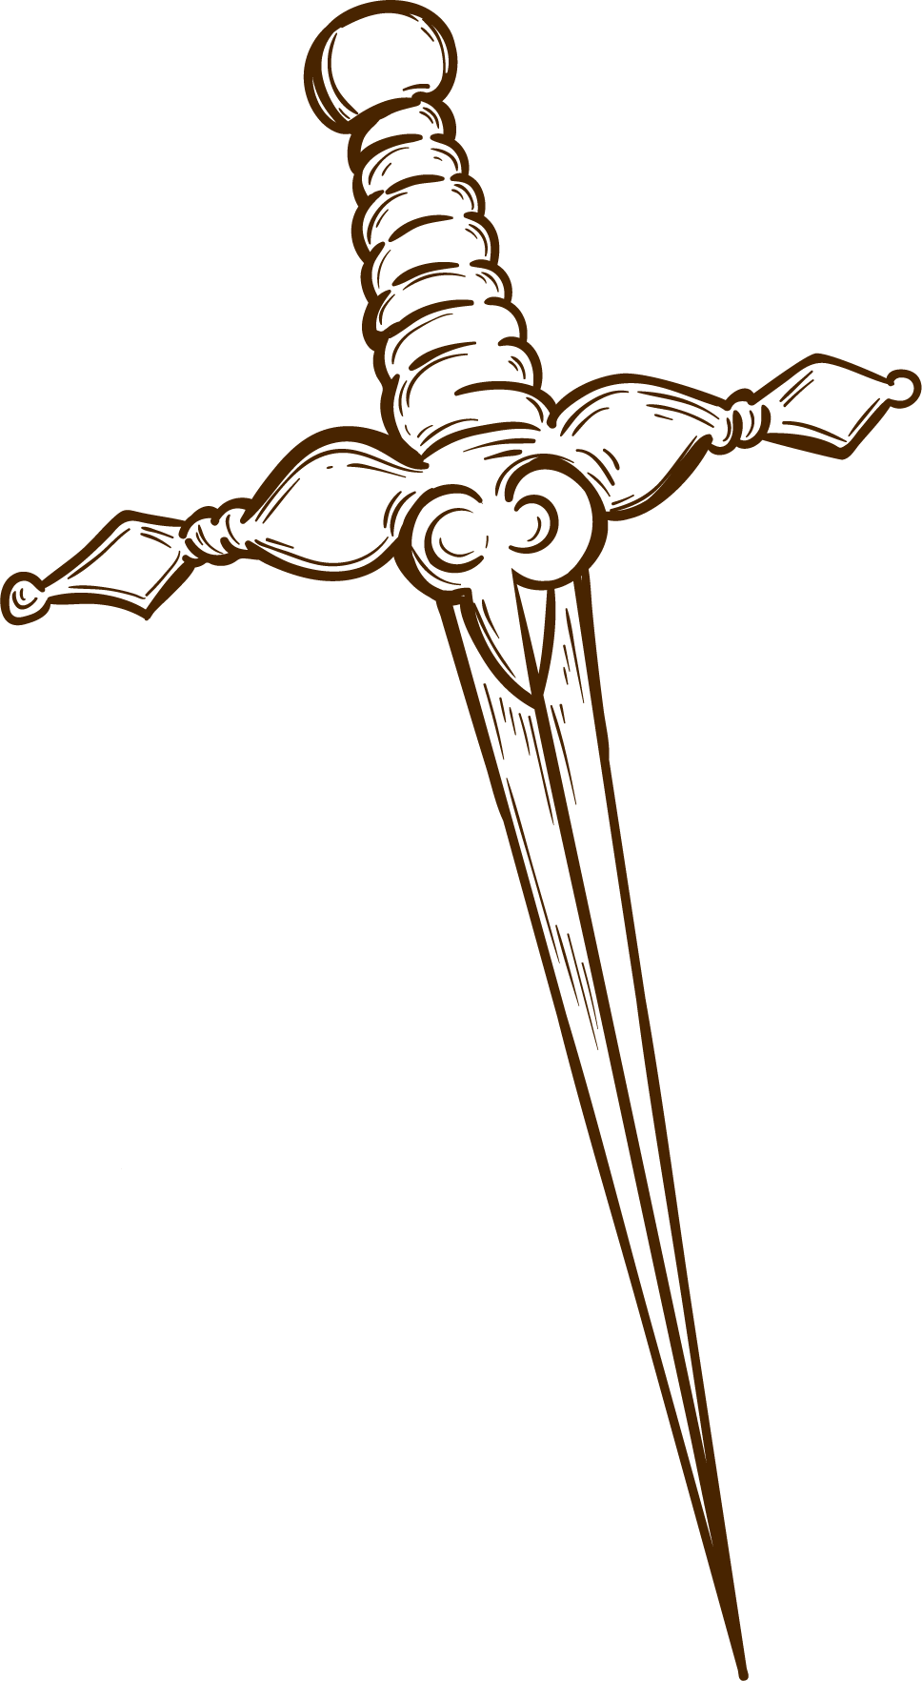
FEATURES OF THE TOPIC
MARS
01
JUPITER
03
MERCURY
02
VENUS
04
Despite being red, Mars is a cold place
It’s the biggest planet in our Solar System
It’s the closest planet to the Sun
Venus is the second planet from the Sun

Slide 8
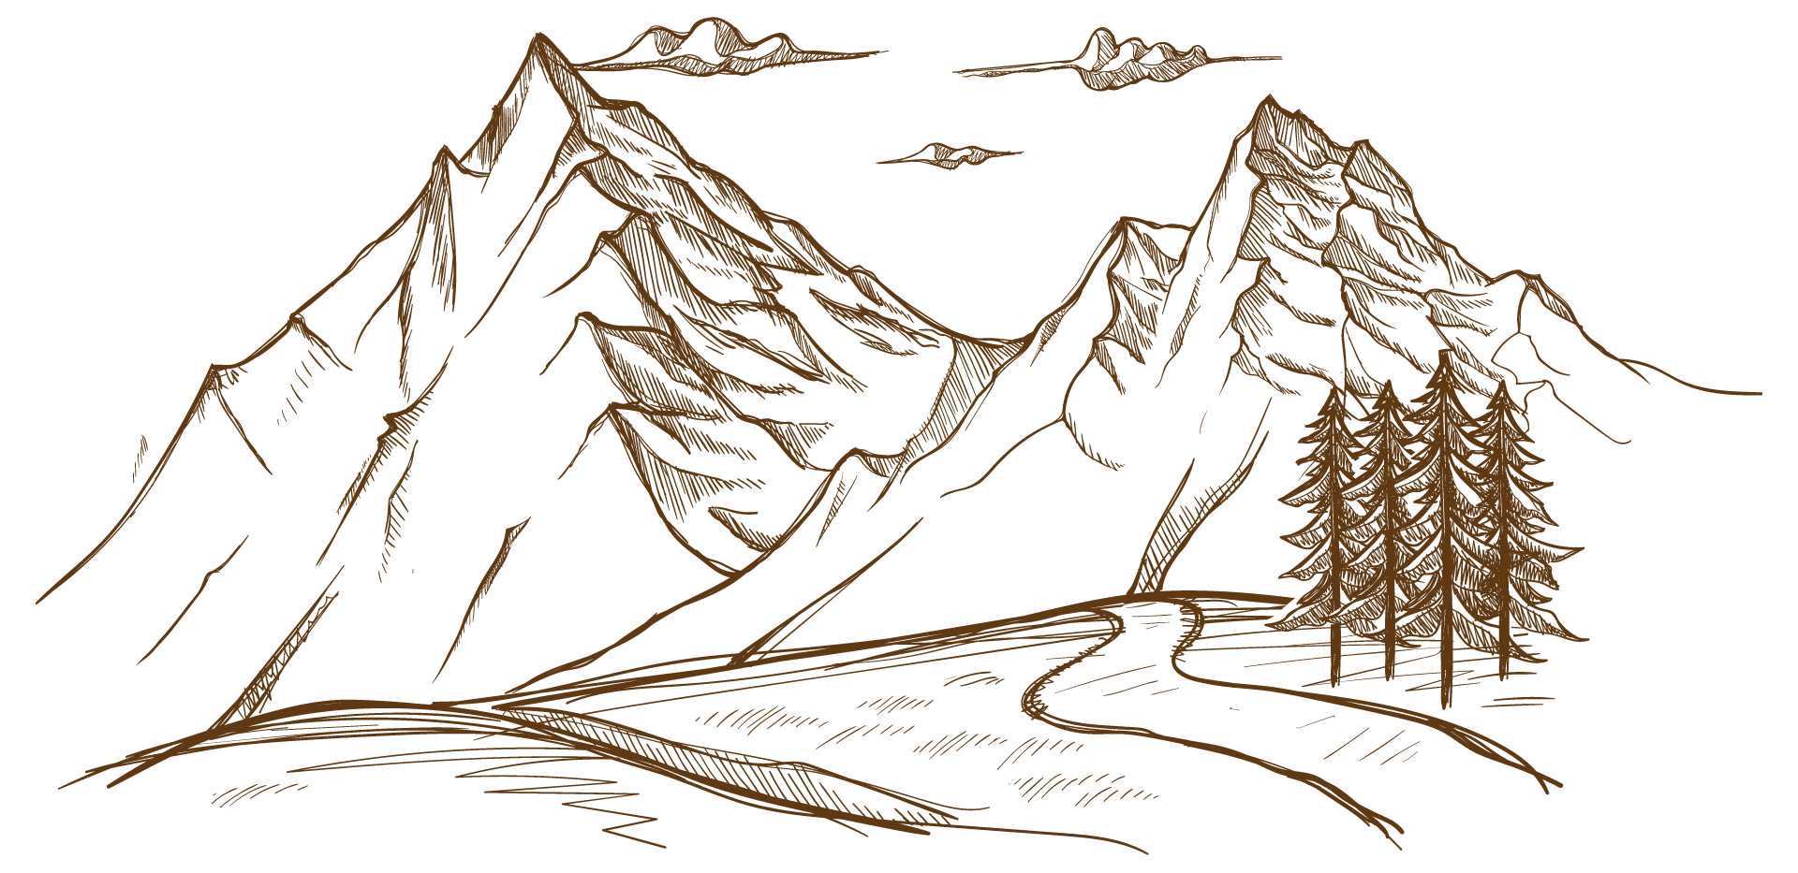
1346
1453
1564
The plague arrives in England
The fall of Constantinople to the Ottoman
William Shakespeare is born

Slide 9
PRACTICAL USES OF THIS SUBJECT
MERCURY
MARS
SATURN
VENUS
NEPTUNE
JUPITER
Mercury is the closest planet to the Sun
Despite being red, Mars is a cold place
Saturn is the ringed one and a gas giant
Venus has a beautiful name, but it’s quite hot
Neptune is the farthest planet from the Sun
It’s the biggest planet in our Solar System

Slide 10
MULTIMEDIA
You can insert your own multimedia content here. It could be a nice addition to your lesson, making it more entertaining

Slide 11
A PICTURE IS WORTH A THOUSAND WORDS

Slide 12
DID YOU KNOW THIS?
01
02
03
SATURN
NEPTUNE
VENUS
Yes, this is the ringed planet. It’s a gas giant, composed of hydrogen and helium
Neptune is the farthest planet from the Sun and the fourth-largest by diameter in our Solar System
It has a beautiful name and is the second planet from the Sun. It’s quite hot, even hotter than Mercury

Slide 13
PROBLEM
SOLUTION
Despite being red, Mars is actually a cold place. It’s full of iron oxide dust, which gives the planet its reddish cast
Venus has a beautiful name and is the second planet from the Sun. It’s terribly hot, even hotter than Mercury

Slide 14
THIS IS A TABLE
 | 1350 | 1400 | 1450 | 1500 | 1550
VENUS | 123 | 444 | 321 | 235 | 452
MARS | 457 | 864 | 1000 | 567 | 678
JUPITER | 34 | 76 | 125 | 97 | 76

Slide 15
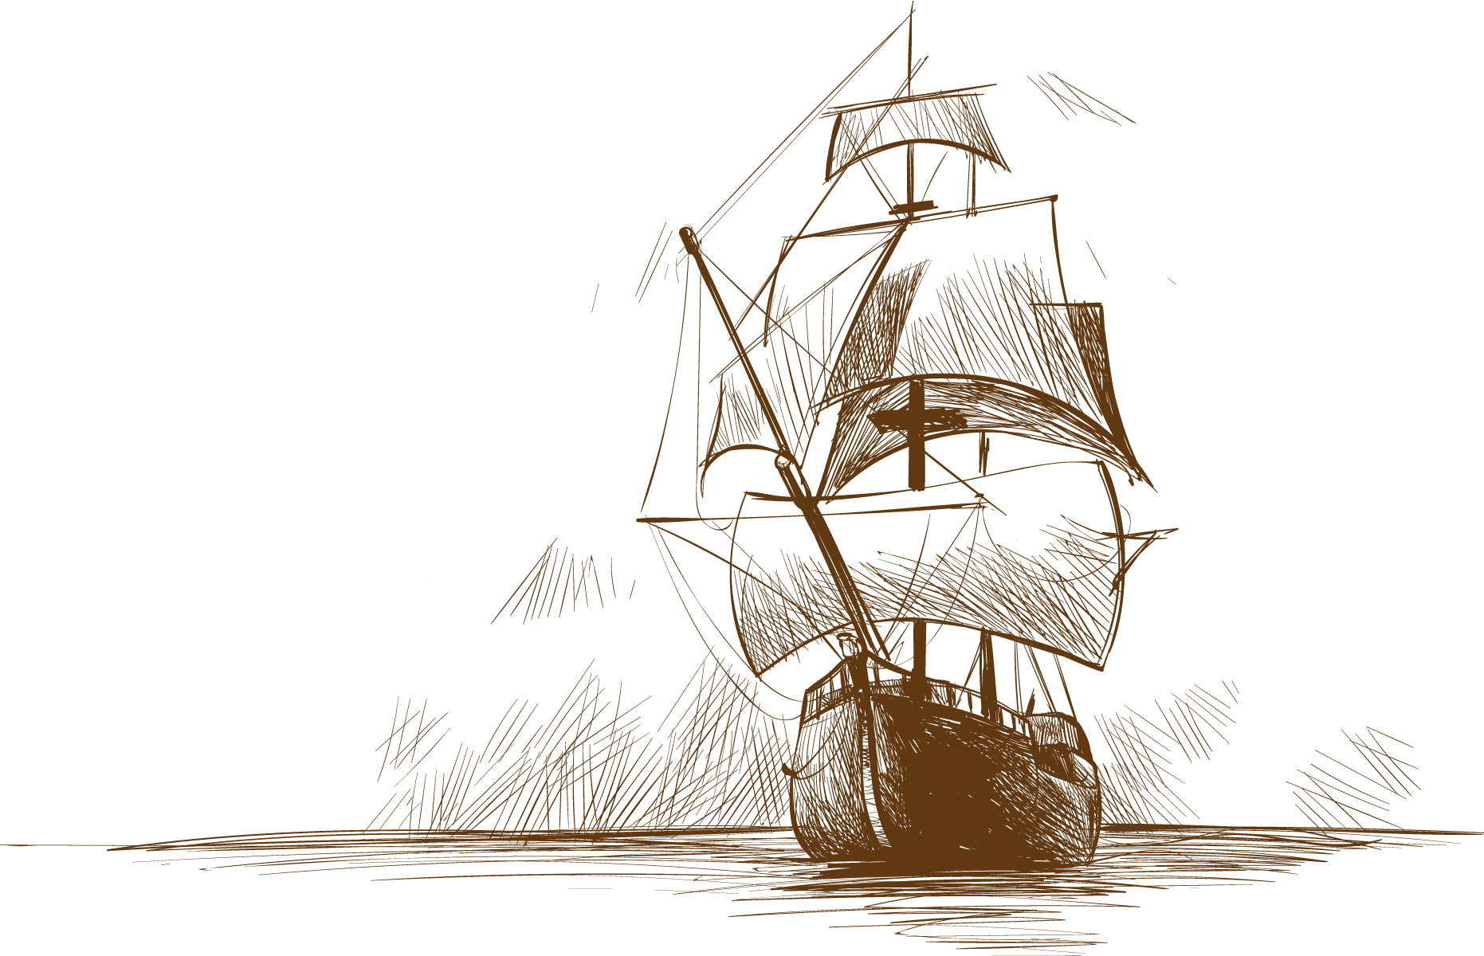
AWESOME WORDS

Slide 16
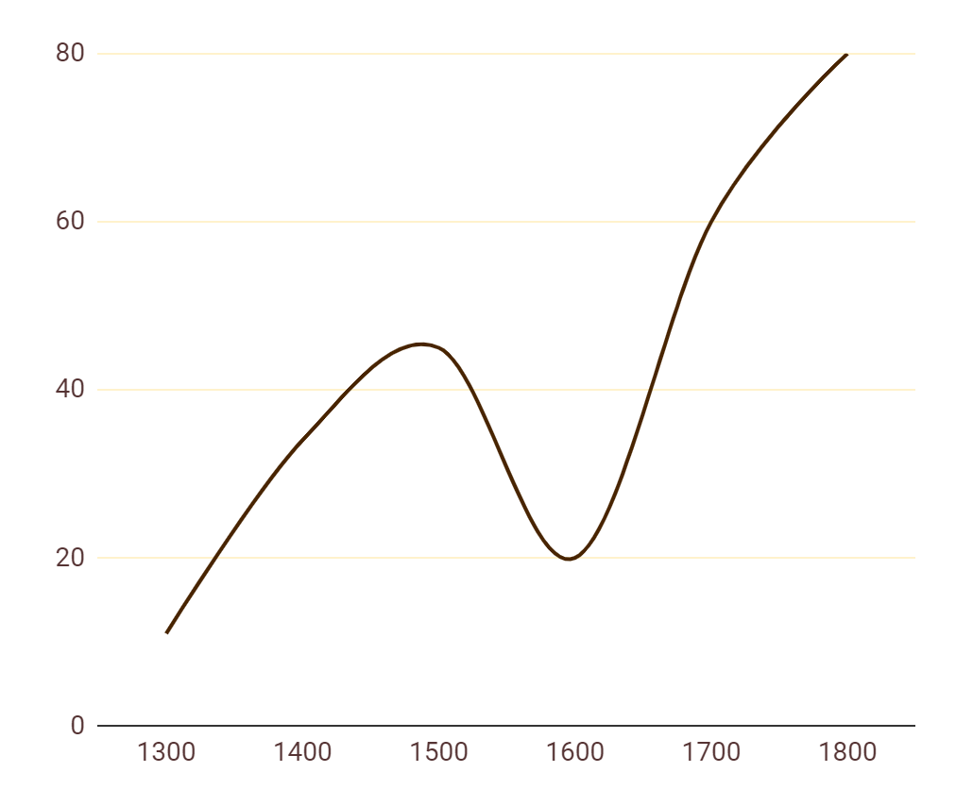
HISTORICAL DATA
VENUS
A
Venus has a beautiful name, but it’s terribly hot
C
MARS
B
Despite being red, Mars is actually a cold place
B
A
JUPITER
C
It’s the biggest planet in our Solar System
If you want to modify this graph, click on it, follow the link, change the data and replace it here

Slide 17
PROCESS
Mercury is the closest planet to the Sun
Despite being red, it’s actually a cold place
1390
MERCURY
1530
MARS
VENUS
1450
SATURN
1610
Venus is the second planet from the Sun
It’s composed of hydrogen and helium

Slide 18
OVERVIEW DIAGRAM
VENUS
Venus has a beautiful name, but it’s terribly hot
MARS
JUPITER
SATURN
Despite being red, it’s actually a cold place
It’s the biggest planet in our Solar System
It’s composed of hydrogen and helium

Slide 19
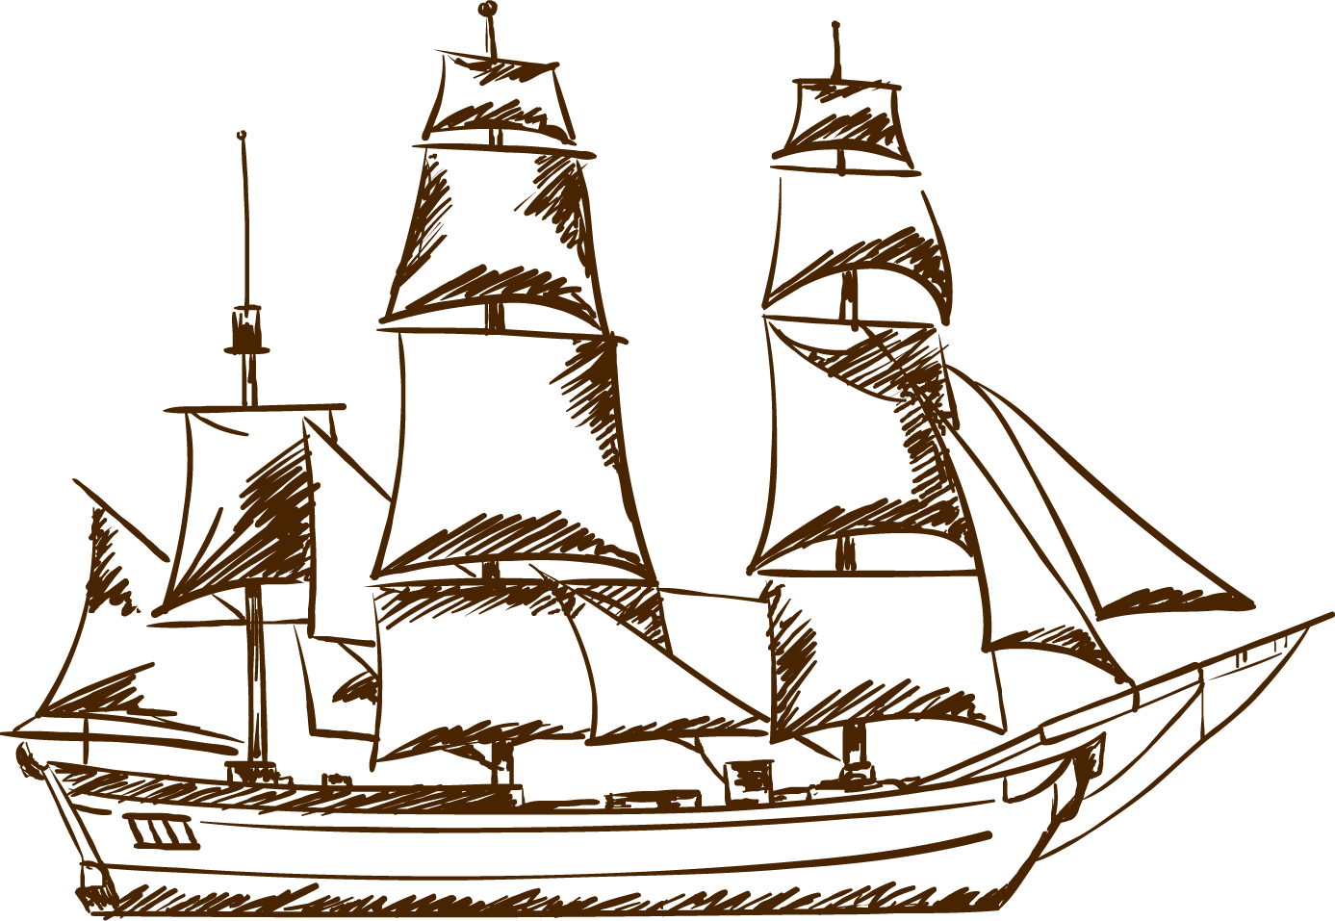
EXERCISE
Fill in the blanks with the name of each part
_____
_____
_____
Mercury is the smallest of them all
Despite being red, Mars is a cold place
Venus has a beautiful name, but it’s too hot

Slide 20
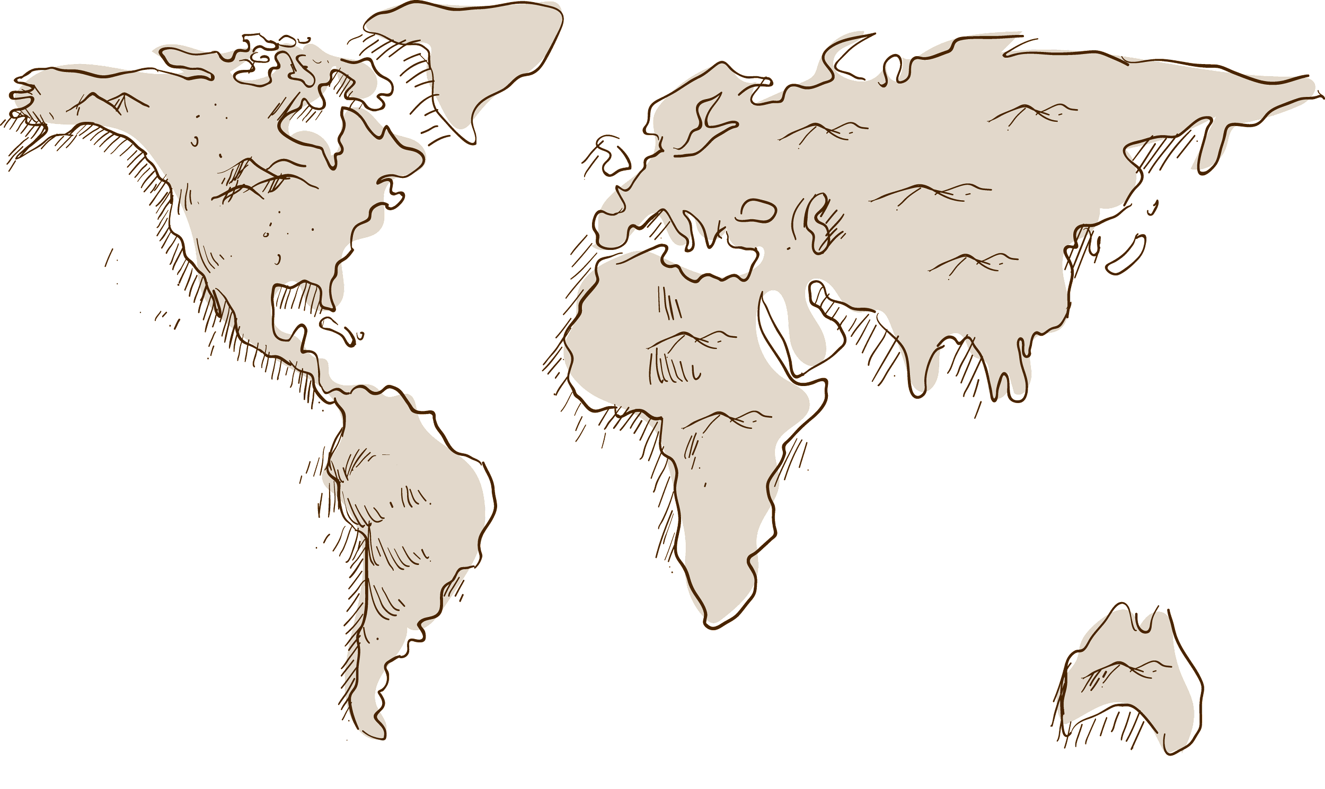
ASSIGNMENT
Venus has a beautiful name, but it’s terribly hot
Mercury is the closest planet to the Sun
Despite being red, Mars is actually a cold place

Slide 21
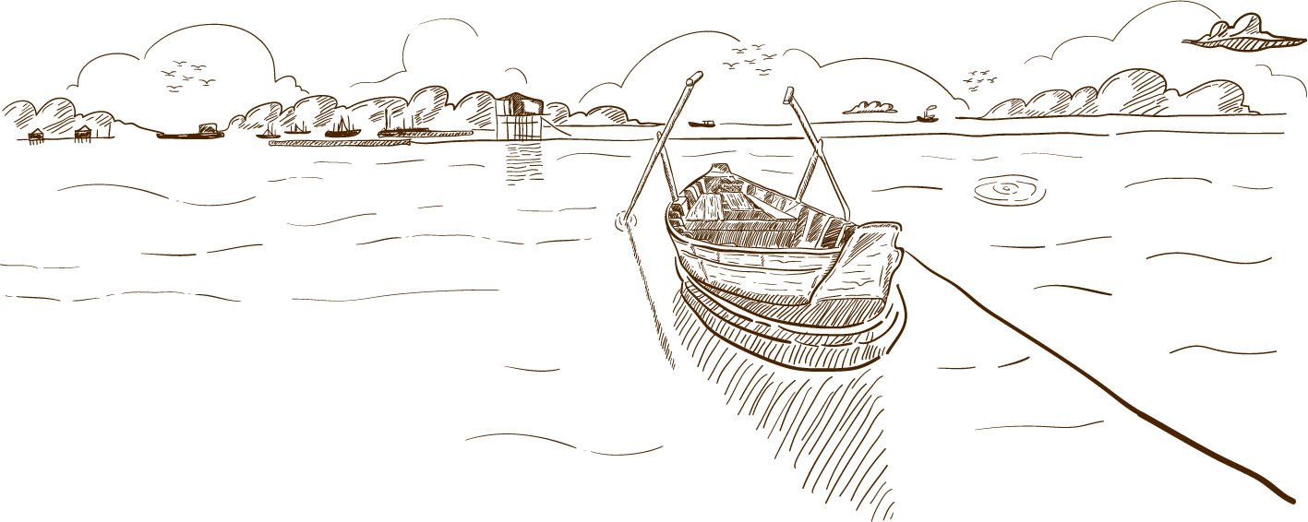
THANKS
Do you have any questions?
youremail@freepik.com
+91 620 421 838
yourcompany.com
Please keep this slide for attribution

Slide 22
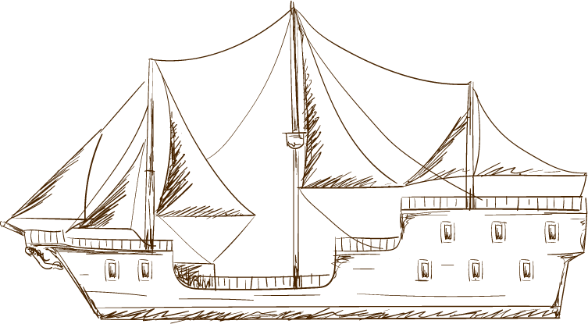
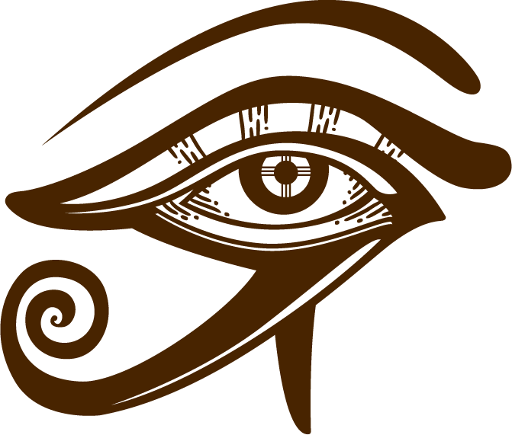
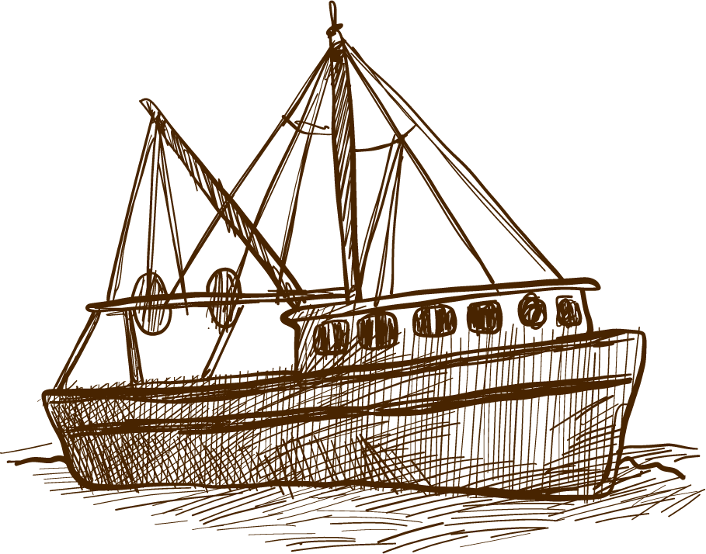
ALTERNATIVE RESOURCES

Slide 23
RESOURCES
Did you like the resources on this template? Get them for free at our other websites.
VECTORS
Sketch background of elegant armor helmet
Sketchy pack of medieval elements
Hand drawn winter landscape background
Hand drawn world book day background
Hand drawn boat with waves background
Sketch of mountains with a path background
Hand-drawn collection of great boats
Background of fishing boat sailing
Sea background with hand drawn boat
Hand drawn lighthouse with boat and other sailor elements
Vintage hand drawn galleon background
Hand drawn egyptian gods and symbols collection
Ancient world map
Stacked books in hand drawn style
PHOTOS
Excellent female student choosing vintage book in library
High angle view of old historic map

